Slide 1
Detection of Deepfakes
Speech Group 06/03/2024
Anthony White

Slide 2
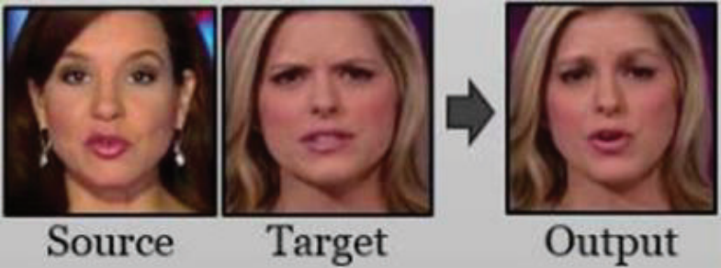
What is a Deepfake?
Deepfake = Deep learning + fakes
Generated using AI and deep learning technology
Artificial images, videos and speech of people
Speech is the easiest to generate and the hardest to detect
Targeted deepfakes can be used in scams and other illegal activity

Slide 3
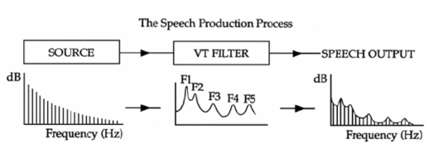
Detecting Deepfakes
Most people are using deep learning approaches, i.e. using deep learning to detect deep learning
My masters will use a signal processing approach
Source-Filter model

Slide 4
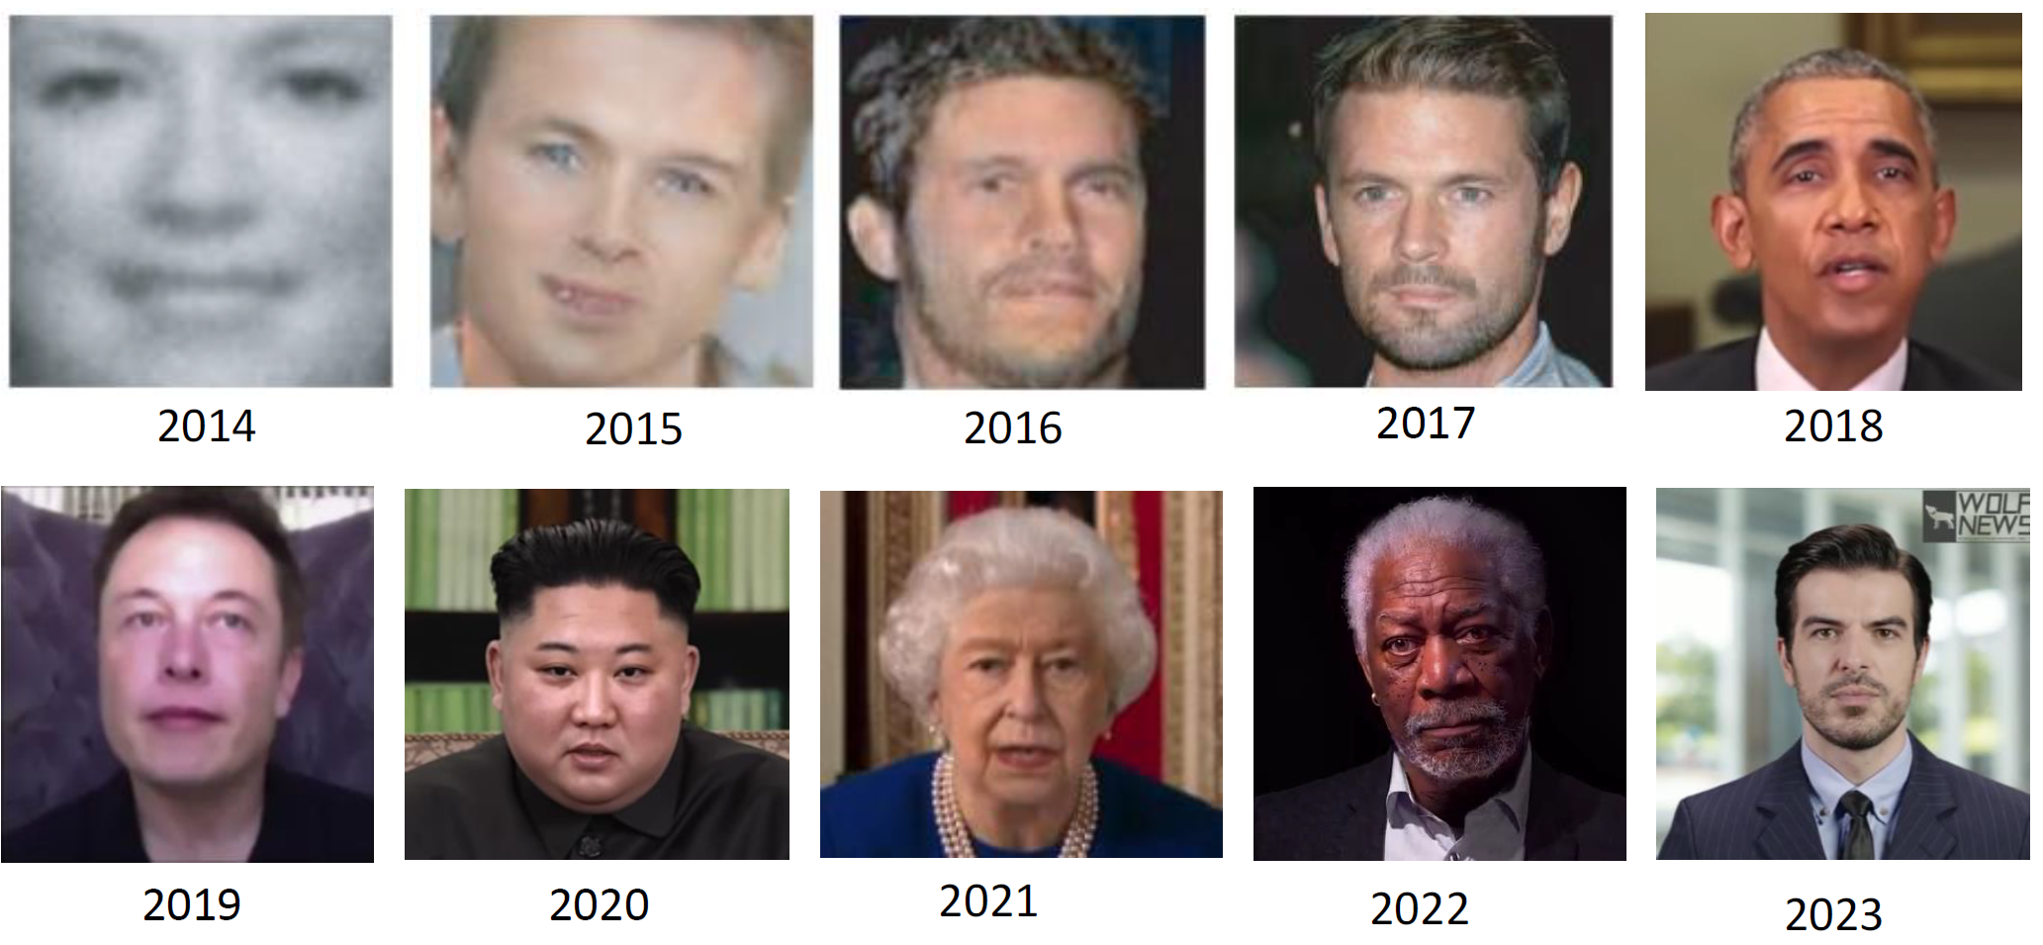
A Decade of Deepfakes
G. Frankovits and Y. Mirsky Discussion Paper: The Threat of Real Time Deepfakes

Slide 5
Detecting Deepfake Voice using Explainable Deep Learning Techniques (Suk-Young Lim, Dong-Kyu Chae and Sang-Chul Lee 2022)
Experiment: output from different XAI methods and DL models are evaluated. Input data consists of spectrogram-based features.
Deep learning models: CNN, CNN-LSTM and CNN-LSTM-permuted.
XAI methods: Deep Taylor, integrated gradients, layer-wise relevance propagation (LRP).
Attribution score of the deepfake detection model is interpreted.
Attribution is recomposed back into audio via the Griffin-Lim algorithm.
CNN – Convolutional Neural Network LSTM – Long Short-Term Memory
XAI – Explainable Artificial Intelligence

Slide 6
Detecting Deepfake Voice using Explainable Deep Learning Techniques (Suk-Young Lim, Dong-Kyu Chae and Sang-Chul Lee 2022)
Datasets: ASVSpoof2019 and LJSpeech. Both sets contain human and synthetic speech.
Deep learning models: CNN, CNN-LSTM and CNN-LSTM-permuted.
XAI methods: Deep Taylor, integrated gradients, layer-wise relevance propagation (LRP).
Spectrogram-based features are used as the input data.
CNN – Convolutional Neural Network LSTM – Long Short-Term Memory
XAI – Explainable Artificial Intelligence

Slide 7
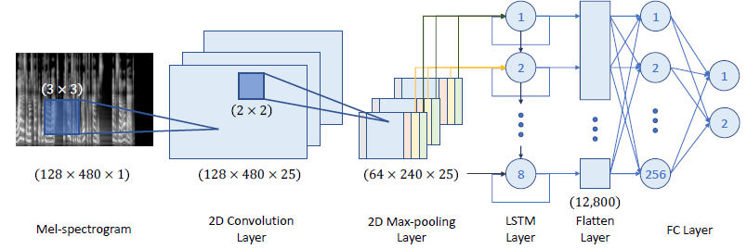
Detecting Deepfake Voice using Explainable Deep Learning Techniques (Suk-Young Lim, Dong-Kyu Chae and Sang-Chul Lee 2022)
Example – CNN-LSTM model structure

Slide 8
Detecting Deepfake Voice using Explainable Deep Learning Techniques (Suk-Young Lim, Dong-Kyu Chae and Sang-Chul Lee 2022)
Integrated gradients XAI methods can be used to calculate attribution score, which describes the importance of each feature in the input for a particular prediction.
By varying each input and feature and measuring what affect this has on the prediction, the gradient can be obtained.
Integrating the gradients gives the total importance for the particular input feature, which is the attribution score.
Generate a heatmap for the input (spectrogram)

Slide 9
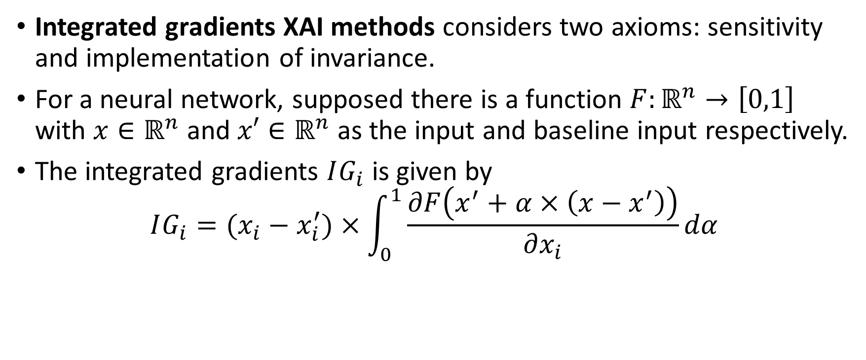
Detecting Deepfake Voice using Explainable Deep Learning Techniques (Suk-Young Lim, Dong-Kyu Chae and Sang-Chul Lee 2022)
Integrated gradients XAI methods considers two axioms: sensitivity and implementation of invariance.
For a neural network, supposed there is a function $F:ℝ^{n}→\left[0,1\right]$ with $x∈ℝ^{n}$ and $x′∈ℝ^{n}$ as the input and baseline input respectively.
The integrated gradients $IG_{i}$ is given by
$$IG_{i}=(x_{i}−x_{i}^{′})×\int_{0}^{1}{\frac{∂F\left(x^{′}+α×\left(x−x^{′}\right)\right)}{∂x_{i}}dα}$$

Slide 10
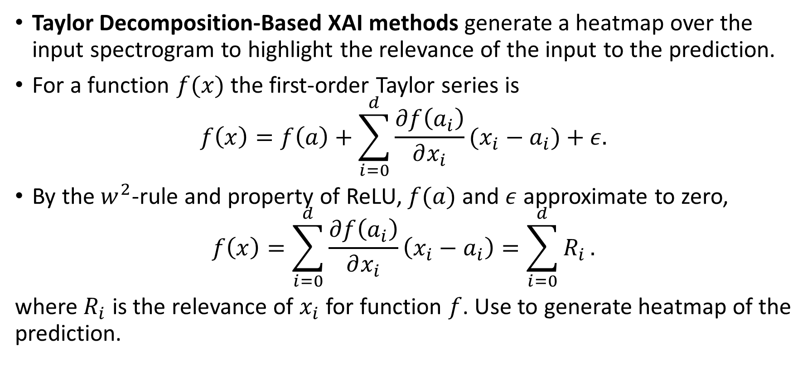
Detecting Deepfake Voice using Explainable Deep Learning Techniques (Suk-Young Lim, Dong-Kyu Chae and Sang-Chul Lee 2022)
Taylor Decomposition-Based XAI methods generate a heatmap over the input spectrogram to highlight the relevance of the input to the prediction.
For a function $f(x)$ the first-order Taylor series is
$$f\left(x\right)=f\left(a\right)+\sum_{i=0}^{d}{\frac{∂f\left(a_{i}\right)}{∂x_{i}}(x_{i}−a_{i})}+ε.$$
By the $w^{2}$-rule and property of ReLU, $f(a)$ and $ε$ approximate to zero,
$$f\left(x\right)=\sum_{i=0}^{d}{\frac{∂f\left(a_{i}\right)}{∂x_{i}}\left(x_{i}−a_{i}\right)=\sum_{i=0}^{d}{R_{i}}}.$$
where $R_{i}$ is the relevance of $x_{i}$ for function $f$. Use to generate heatmap of the prediction.

Slide 11
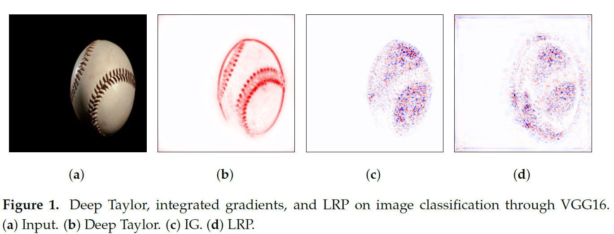
Detecting Deepfake Voice using Explainable Deep Learning Techniques (Suk-Young Lim, Dong-Kyu Chae and Sang-Chul Lee 2022)
Attribution score generated for an example image using each of the XAI methods

Slide 12
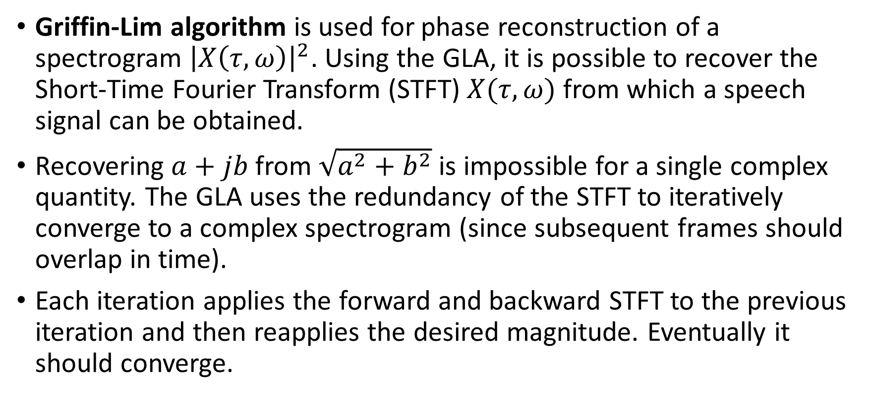
Detecting Deepfake Voice using Explainable Deep Learning Techniques (Suk-Young Lim, Dong-Kyu Chae and Sang-Chul Lee 2022)
Griffin-Lim algorithm is used for phase reconstruction of a spectrogram ${\left|X\left(τ,ω\right)\right|}^{2}$. Using the GLA, it is possible to recover the Short-Time Fourier Transform (STFT) $X(τ,ω)$ from which a speech signal can be obtained.
Recovering $a+jb$ from $\sqrt{a^{2}+b^{2}}$ is impossible for a single complex quantity. The GLA uses the redundancy of the STFT to iteratively converge to a complex spectrogram (since subsequent frames should overlap in time).
Each iteration applies the forward and backward STFT to the previous iteration and then reapplies the desired magnitude. Eventually it should converge.

Slide 13
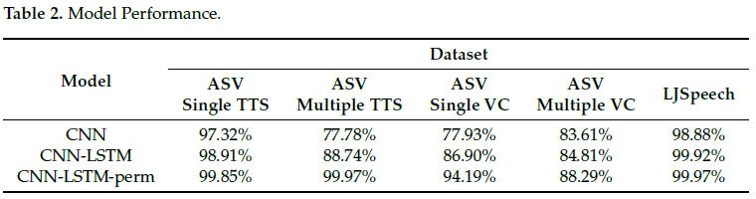
Detecting Deepfake Voice using Explainable Deep Learning Techniques (Suk-Young Lim, Dong-Kyu Chae and Sang-Chul Lee 2022)
TTS – Text to Speech See paper for spectrogram plots for each model
VC – Voice conversion model

Slide 14
Detecting Deepfake Voice using Explainable Deep Learning Techniques (Suk-Young Lim, Dong-Kyu Chae and Sang-Chul Lee 2022)
Interpretability is focused on a visual model using a heatmap on a spectrogram.
Griffin-Lin algorithm is used to convert attribution scores of each model and XAI methods to recompose spectrogram back to audio.
CNN only model: most of the original voice was recovered during conversion from attribution score. Transcript of original voice is recognisable from the recomposed voice.
CNN-LSTM model: For Deep Taylor and LRP, transcript of recomposed voice is unrecognisable due to lack of sensitivity on formants 1, 2 and 3.

Slide 15
Warning: Humans Cannot Reliably Detect Speech Deepfakes (Kimberly T. Mai, Sergi Bray, Toby Davies, Lewis D. Griffin 2023)
In 2020, a bank manager in Hong Kong received a call from a company director he had spoken to before, requesting a transfer of $35 million USD. After transferring $400,000, he realised that this call was an elaborate deepfake scam.
Another incident involves a UK-based firm being scammed over the phone, transferring €220,000 to a fake Hungarian supplier.
It is estimated that as much as 90% of online content will be synthetically generated by 2026.
Schick N. Deep Fakes and the Infocalypse: What You Urgently Need To Know. Hachette; 2020.

Slide 16
Warning: Humans Cannot Reliably Detect Speech Deepfakes (Kimberly T. Mai, Sergi Bray, Toby Davies, Lewis D. Griffin 2023)
In this research article, an experiment is performed to evaluate people’s ability to detect speech deepfakes.
It was found that deepfakes can be correctly identified around 73% of the time.
Deepfake voice generated using publicly available TTS technology, specifically VITS.
Tests done in English and Mandarin
Unary tests – samples listened to one by one
Binary tests – two samples listened to (A and B). One real and one fake
VITS - Conditional Variational Autoencoder with Adversarial Learning for End-to-End Text-to-Speech

Slide 17
Warning: Humans Cannot Reliably Detect Speech Deepfakes (Kimberly T. Mai, Sergi Bray, Toby Davies, Lewis D. Griffin 2023)
Reference audio helps with deepfake detection
Training humans to detect deepfakes only helps slightly
Equally challenging to detect deepfakes in Mandarin and English
Shorter deepfakes are not easier to identify
Listening to clips more frequently does not aid detection
Spending more time on the task does not affect performance
Participants do not get better throughout the task without explicit feedback
Human performance is less sensitive to unknown conditions compared to automated detectors
Crowd speech deepfake detection is comparable to the top-performing automated detectors

